Slide 2


Slide 3
Immunologic monitoring in kidney transplant recipients

Slide 7
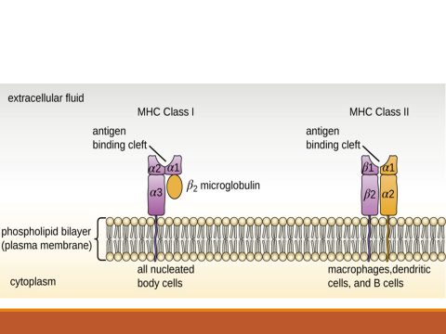

Slide 8
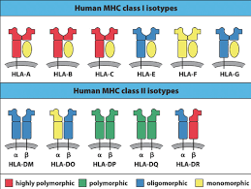

Slide 10
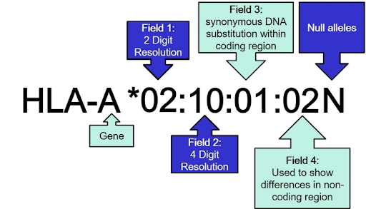

Slide 11
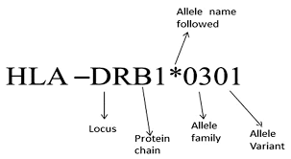

Slide 14
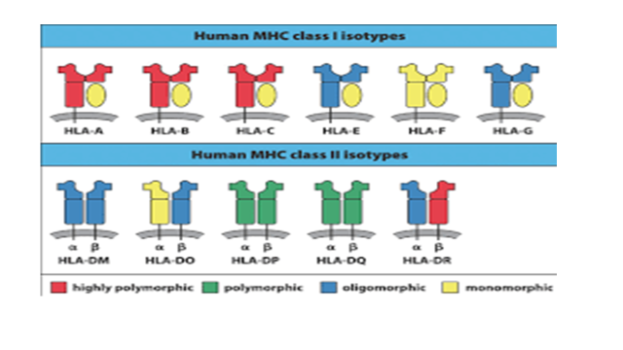

Slide 16
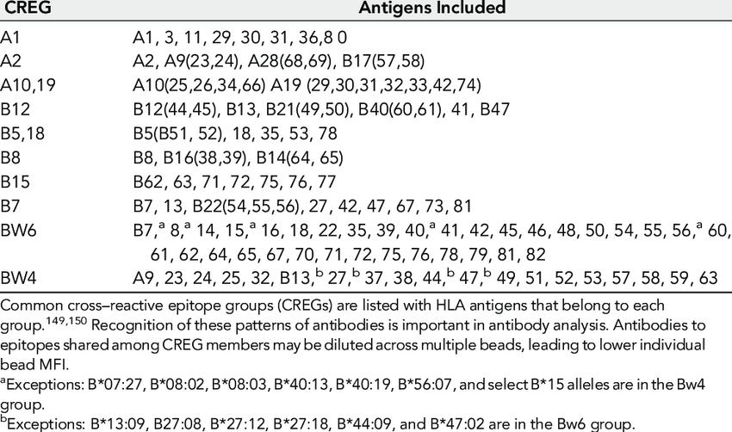

Slide 20
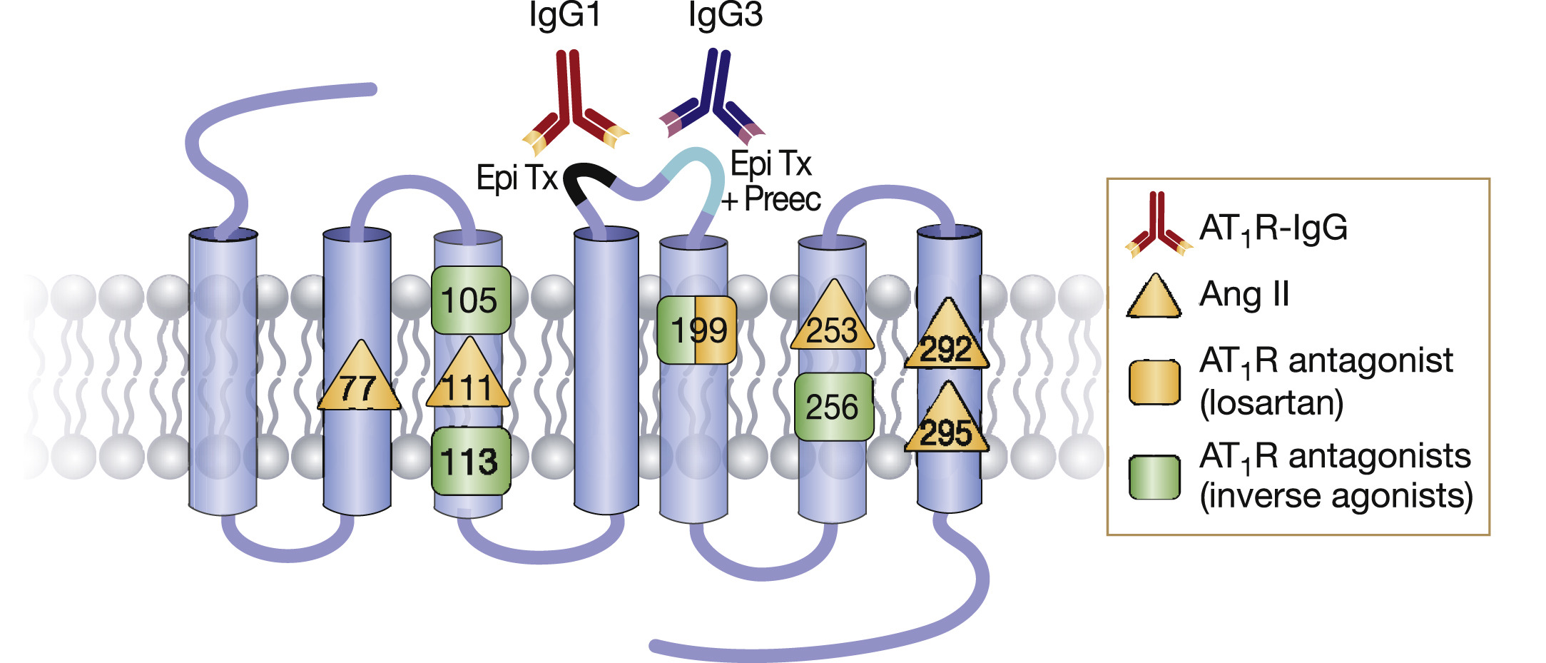

Slide 21
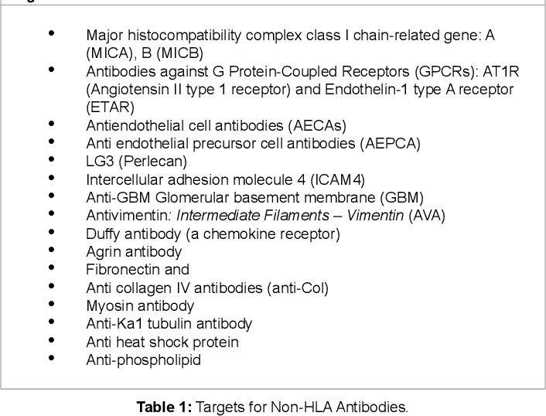

Slide 22
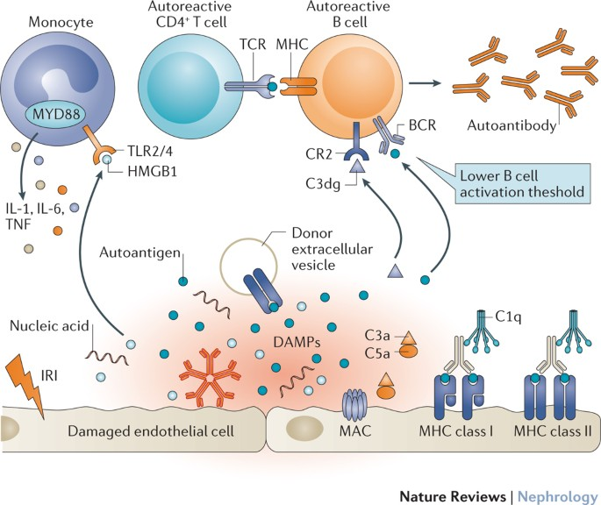

Slide 23
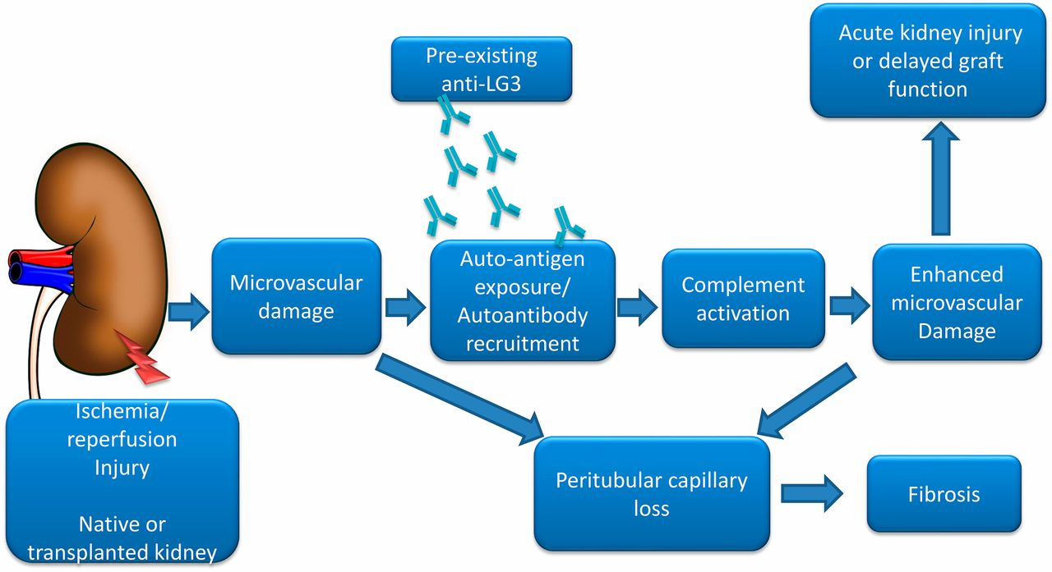

Slide 27
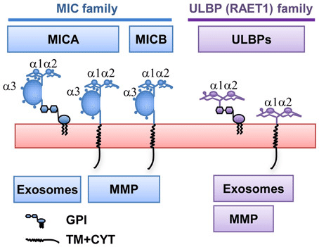

Slide 28
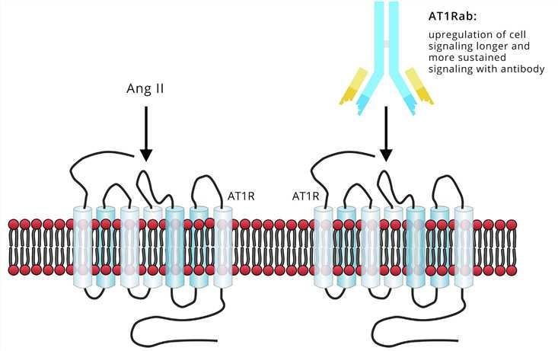

Slide 29
American Journal of Transplantation 2013; 13: 2577–2589

Slide 30
Re-transplanted patients (p < 0.0001), males (p=0.008) and those with FSGS (p=0.04) and younger (p=0.04) at time of transplantation were more likely to be positive for AT1R-Ab prior to transplantation. Recipients who were positive for AT1R-Ab prior to transplantation had increases in
serum creatinine within 3 months post-transplantation (p < 0.0001) and developed abnormal biopsies earlier than did AT1R-Ab negative patients.

Slide 31
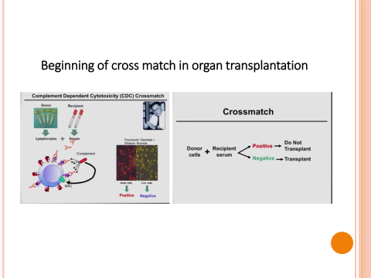

Slide 33
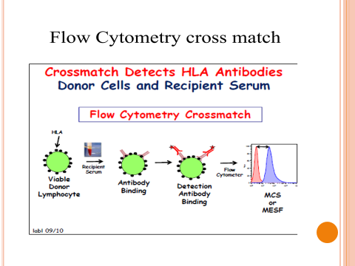

Slide 35
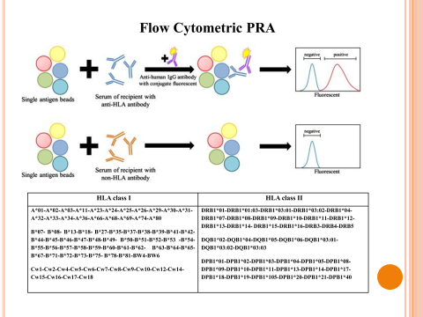

Slide 36
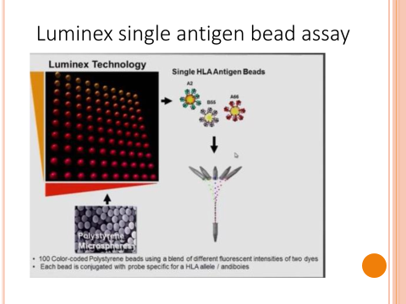

Slide 37
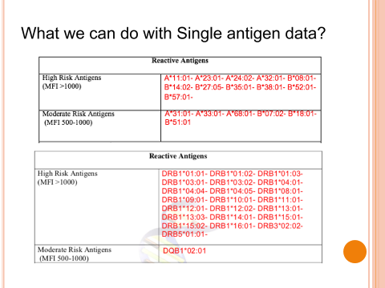

Slide 38
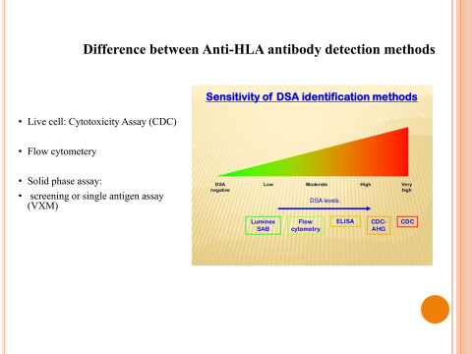

Slide 39
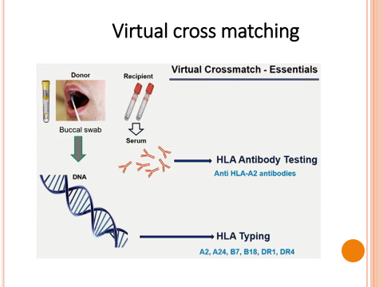

Slide 40
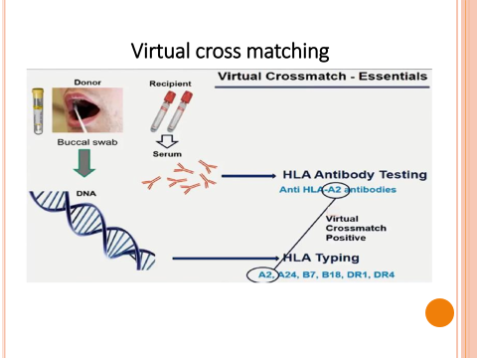

Slide 41
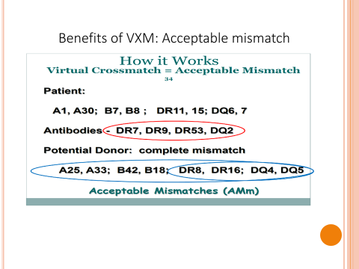

Slide 43
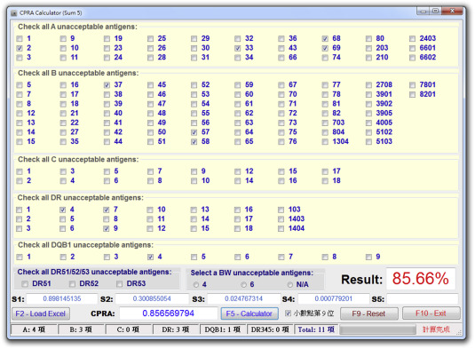

Slide 44
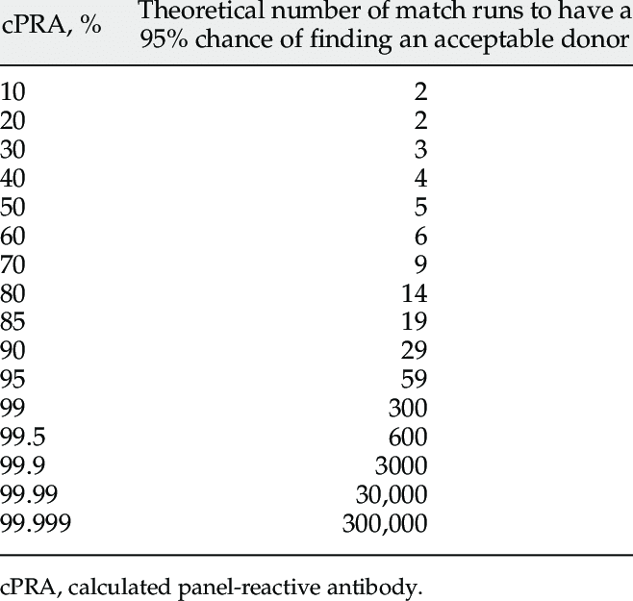

Slide 46
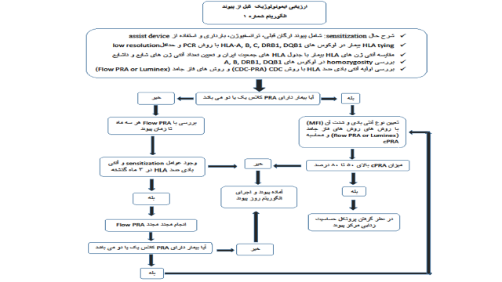

Slide 48
